Slide 1
AI Implementer

Slide 2
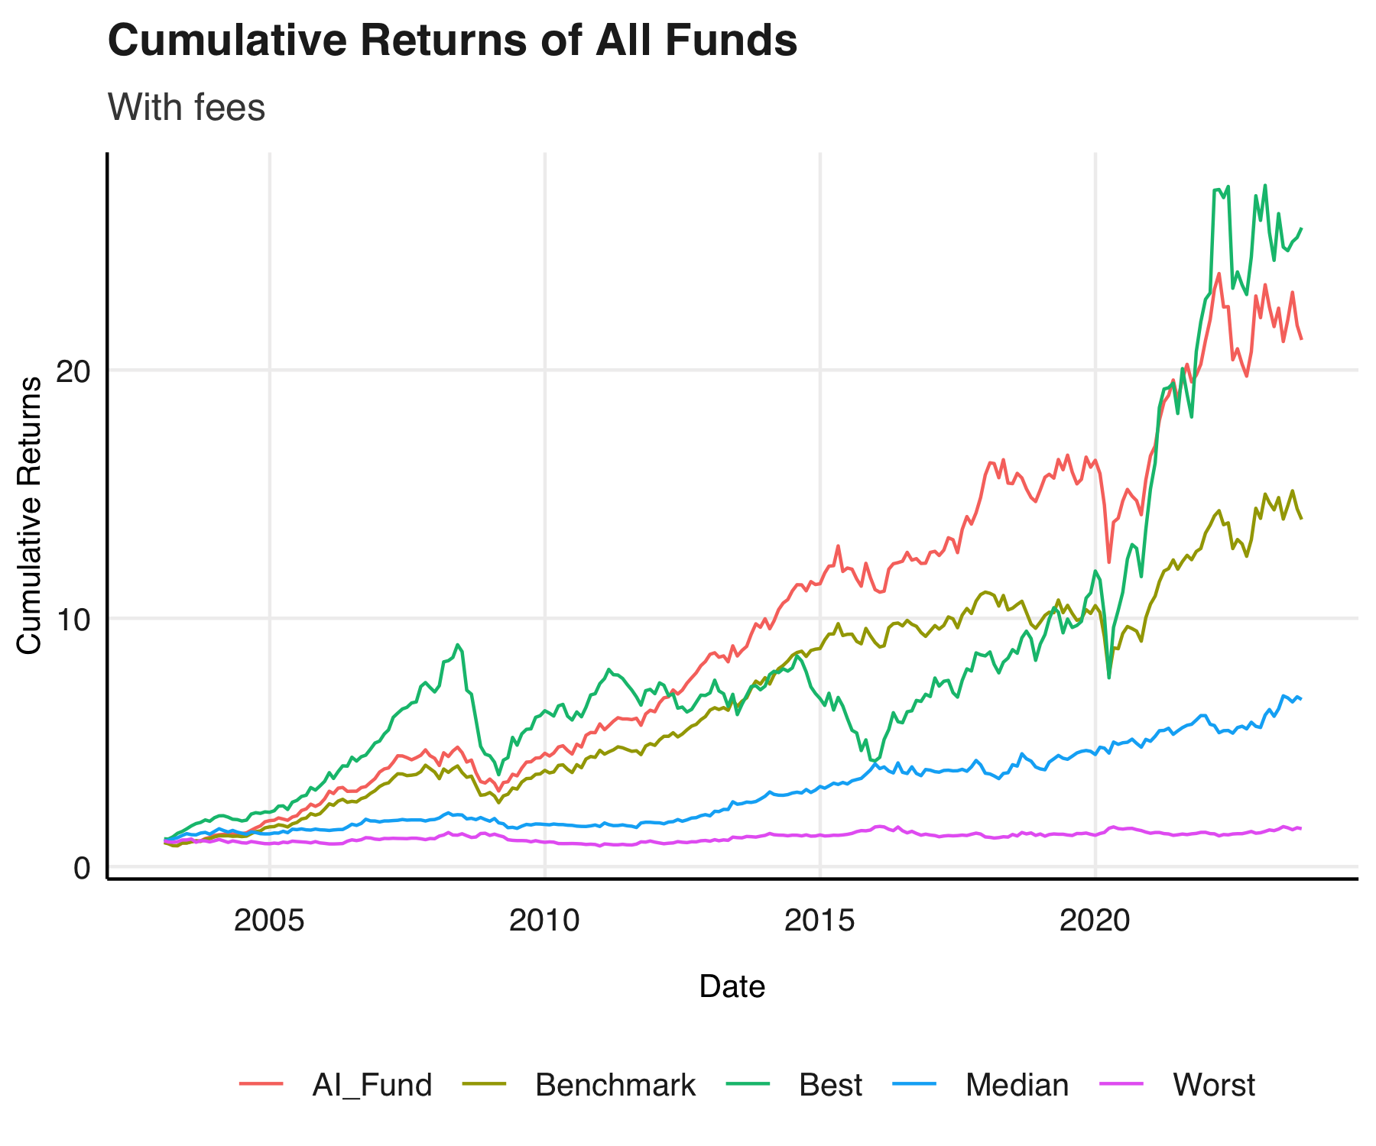
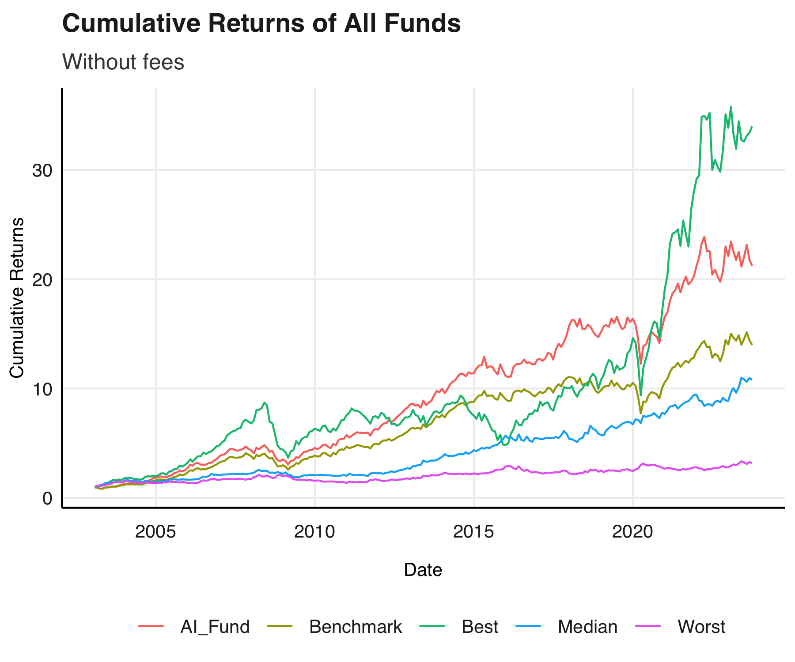
A yearly fee of 200bps

Slide 3
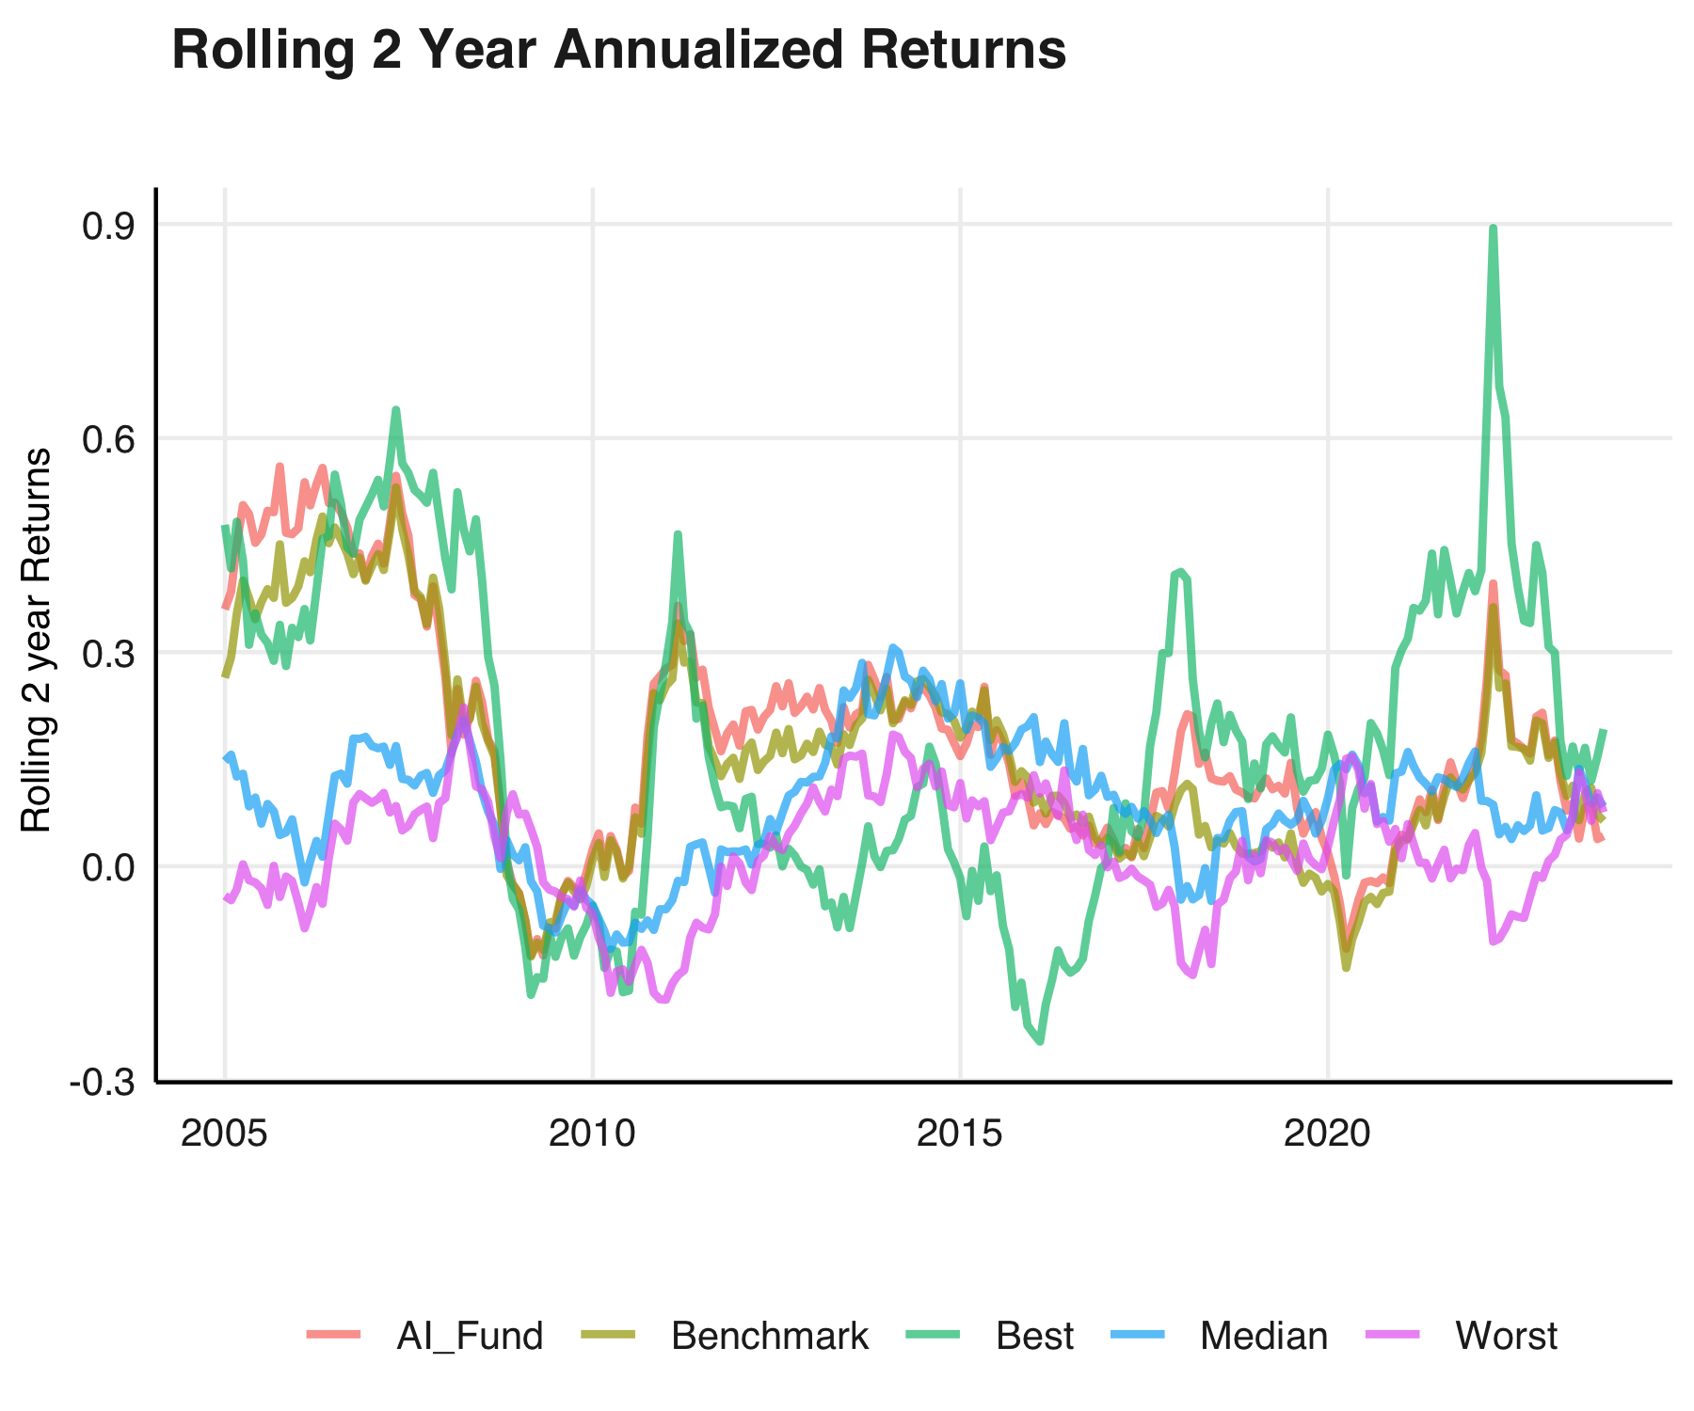
Returns?
Consistently outperforms the median manager and competes with the best manager

Slide 4
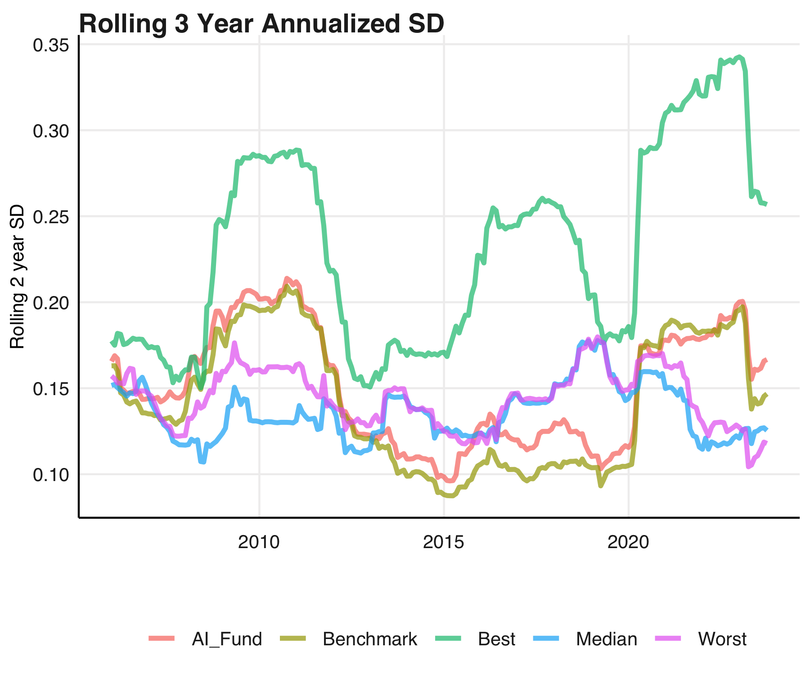
Risk?
It is clear to see that the best active fund is much riskier than our AI fund.

Slide 5
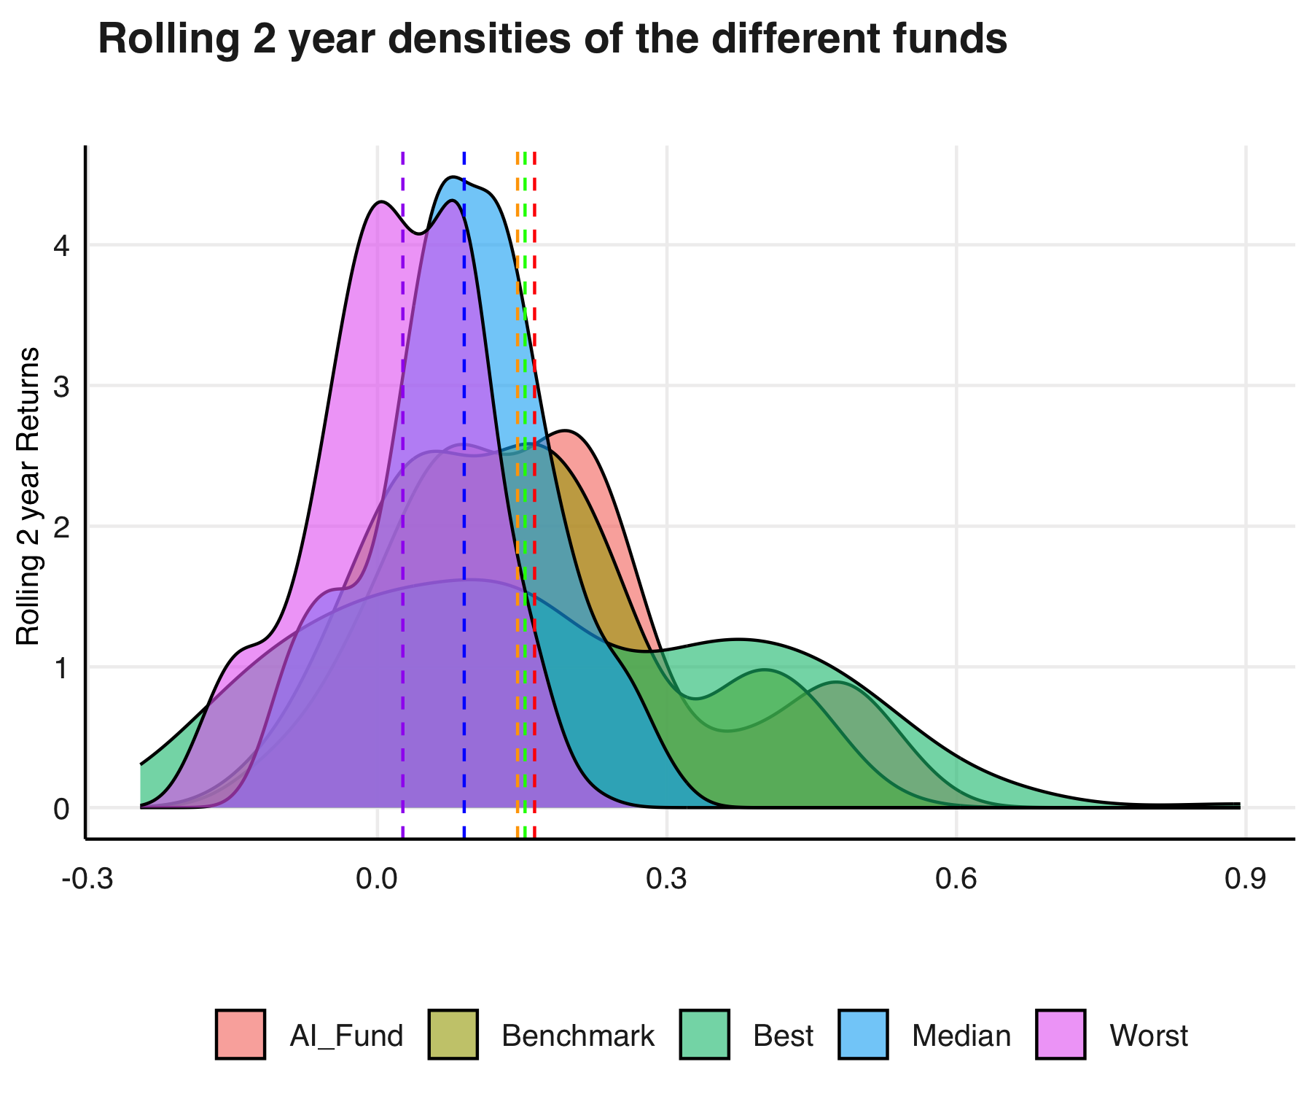
Sharpe
Our AI fund has the highest median return beating both the benchmark and the best actively manged fund (after fees)

